Slide 1
Advanced Systems Analysis and Design Work Management systems SOFT 30121 L4

Slide 2
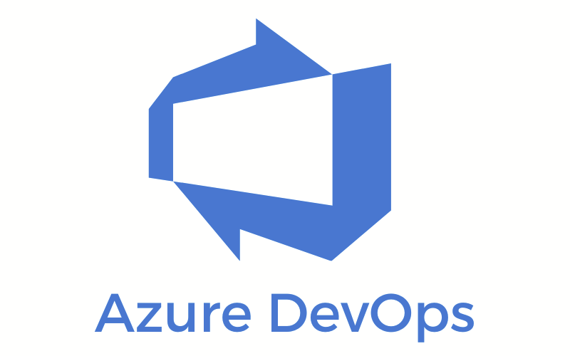

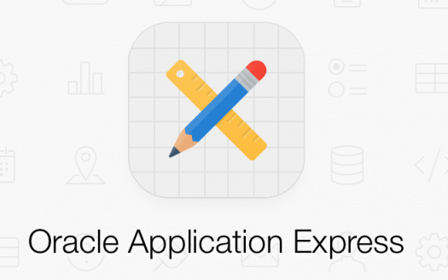

Workflow/Project management systems

Slide 3
The Systems Analyst and Information Systems Development
Objectives of Lecture 4
What are workflow management systems used for?
What workflow management systems exist?
How can workflow management systems be used with an agile development methodology?
How to import a backlog into Azure DevOps Boards
How to get the most out of these systems
How work management systems help with mutual accountability and trust

Slide 4
Why Work Management Systems are important?
Workflow management systems make it easy for all stakeholders to see what work is left to complete
They provide useful tools to track the status of the project
They make it easier for developers to self-manage
They can also aid in measuring developer productivity (through tracking resolved issues, tasks completed etc.)

Slide 5
Azure DevOps
Microsoft’s solution to DevOps and work management
Replaced Team Foundation Server
Integrates well with other Microsoft technologies, like Visual studio, Teams, and even PowerPoint and Excel
Has a focus on test management
Free version is limited to 5 users

Slide 6
Jira
The current market leader in work management systems
Highly configurable
Supports different agile methodologies
Free version is limited to 10 users

Slide 7

GitHub (and ZenHub)
Github primarily provides hosting for git version control and source code management, but also provides some work management functionality
The projects tab repositories provides Kanban style boards
Azure DevOps and Jira both have GitHub integration if you just want to use GitHub for source control
ZenHub adds more functionality to GitHub’s project tab

Slide 8
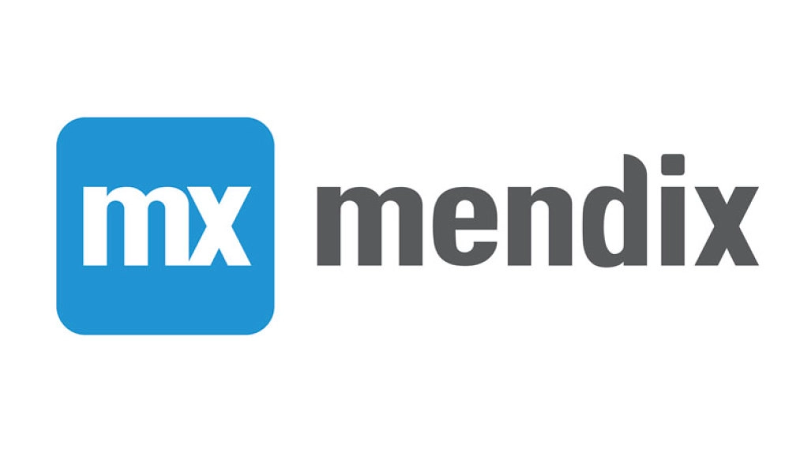
Oracle Apex and Mendix
Both of these are low-code development environments, which are great if you struggle with programming
Issue log

Slide 9


Some of the rest…
Trello is more lightweight, and designed as a Kanban board tool. It doesn’t handle time tracking or automatic reporting
Basecamp is more targeted at project management of any kind, rather than systems development. Has some useful collaboration features. No Kanban/scrum boards however

Slide 10
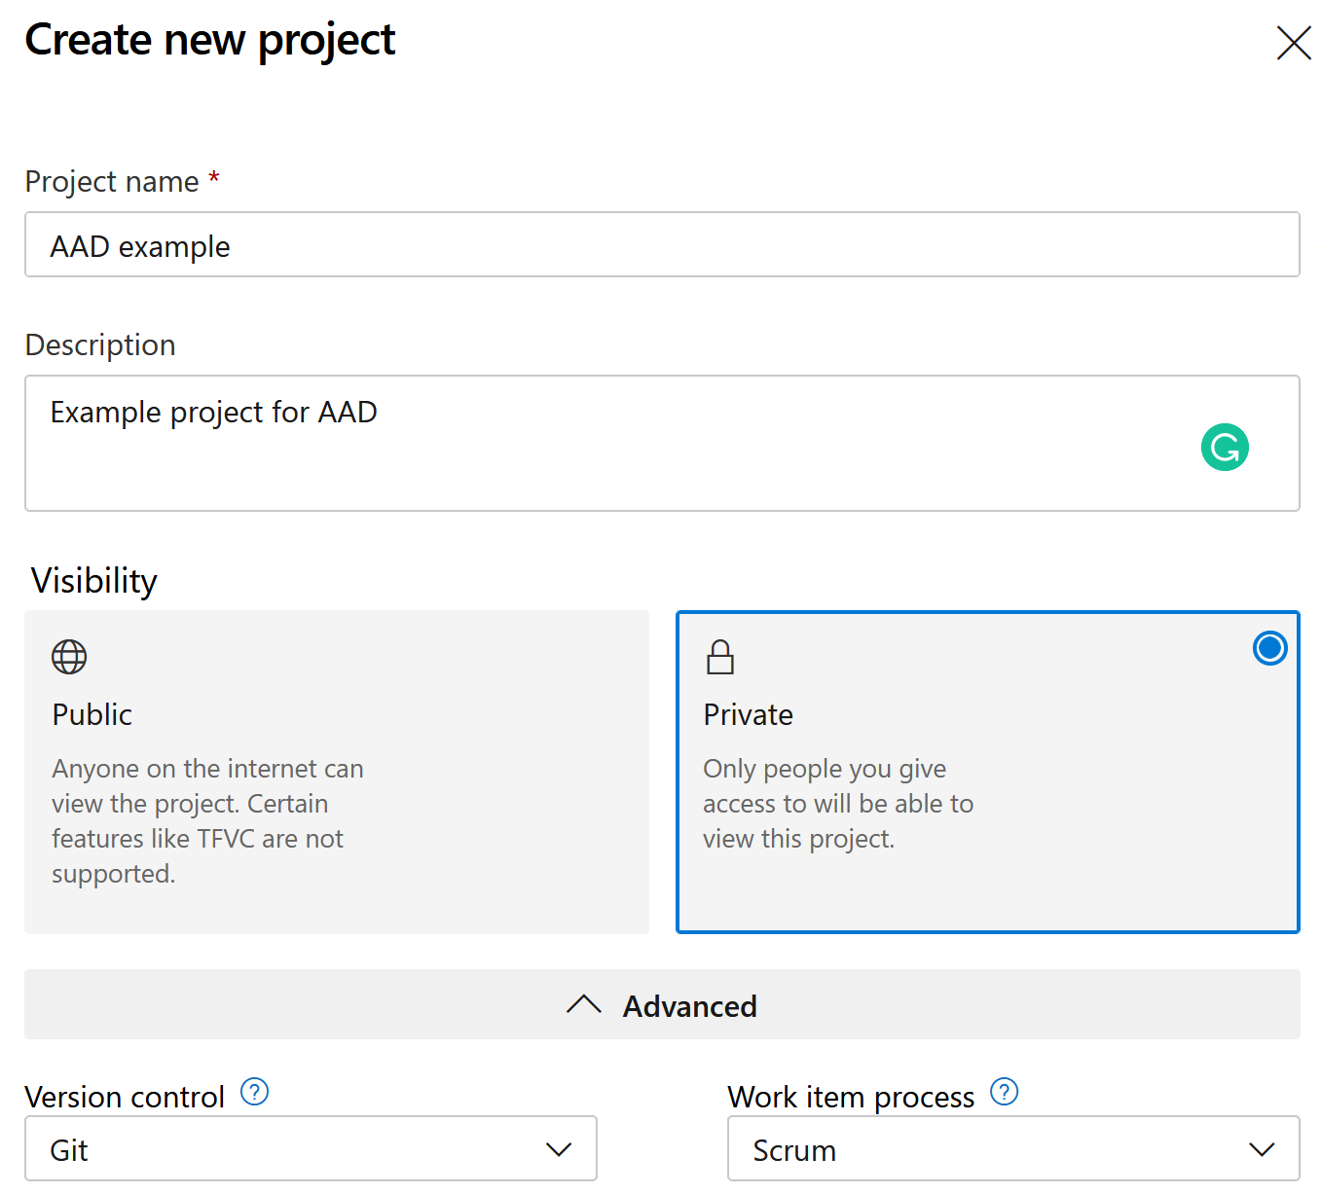
Using Azure DevOps as an example
Scrum has been chosen here as the work item process model.
This allows you to track backlog items

Slide 11
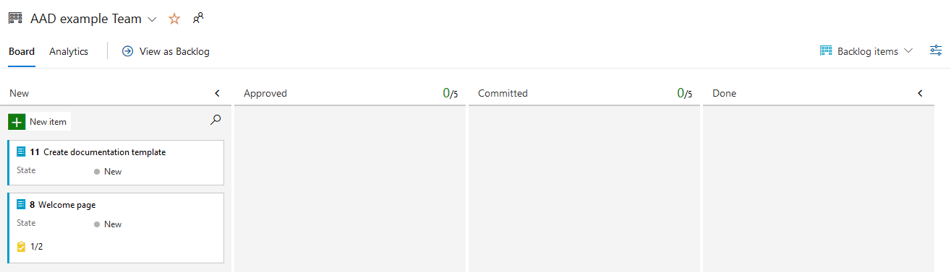
Using Azure DevOps as an example
The Kanban board can be used to track the status of your backlog items
On the “Work items” page it is also possible to import your backlog from a csv file.

Slide 12
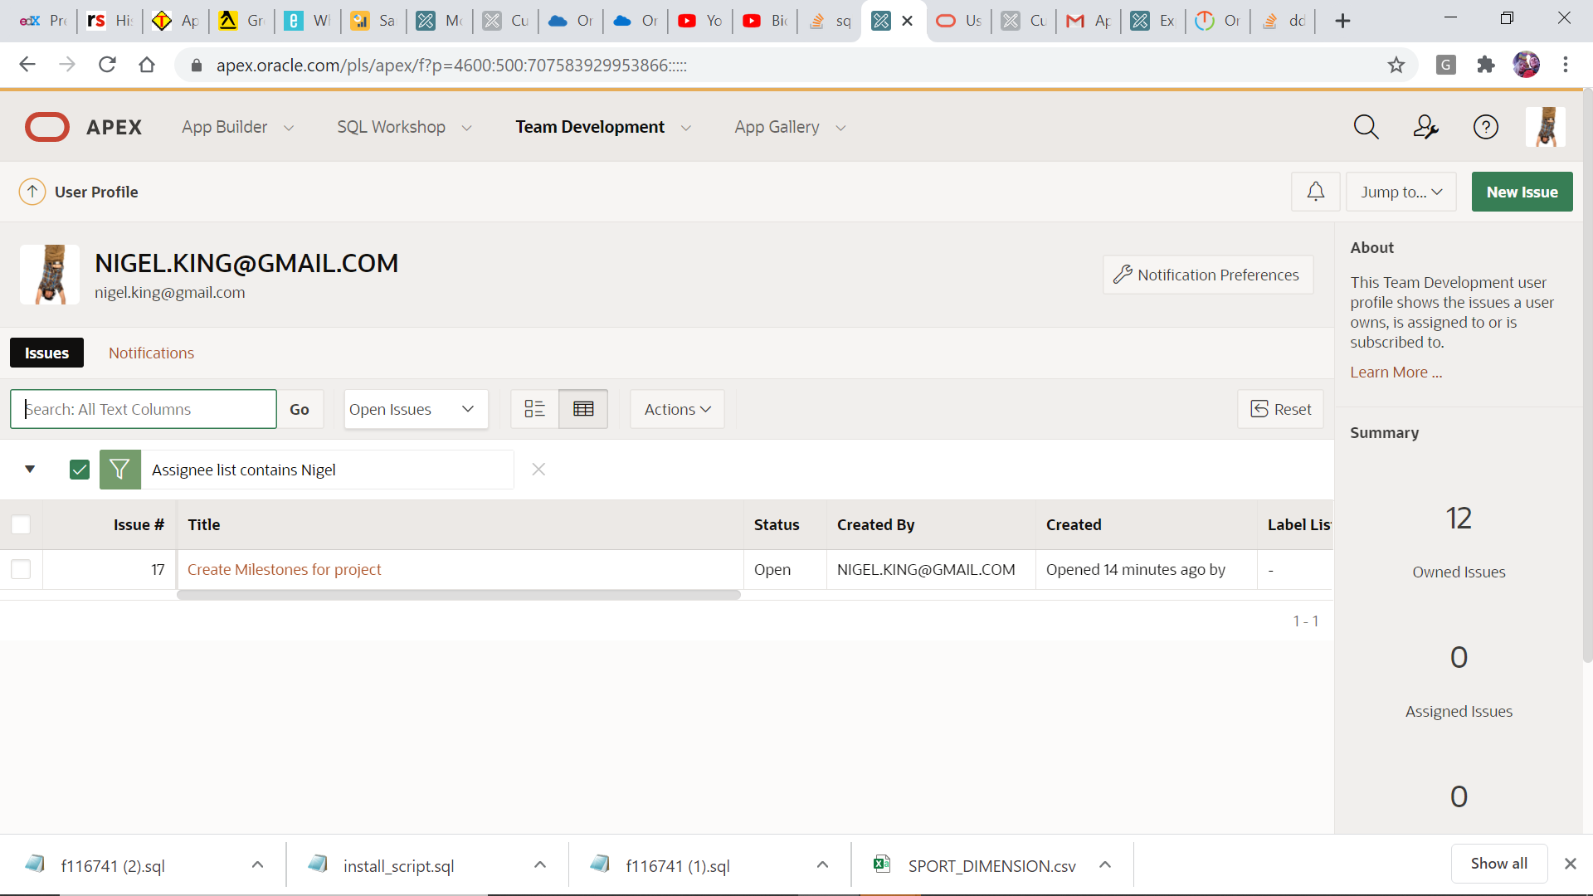
Apex Work Management:

Slide 13
Apex Work Management: Features
Embedded in the IDE
Issues Linked to the actual pages in the IDE
Subscribe to notifications when anything changes
Link issues with project milestone dates

Slide 14
Apex Work Management: Features
Create issues and assign them as you find them
Templates for Features and Bugs to structure pertinent info.

Slide 15
Next Lecture
Requirements Determination

